Slide 1

ISCG 6426 Data Structures And Algorithms Project
Vibhor Gupta
1481740

Slide 2
Agenda:
Demonstrate the project
Demonstrate C# Windows Form Application UI
Demonstrate how bubble sort took longer than selection sort

Slide 3
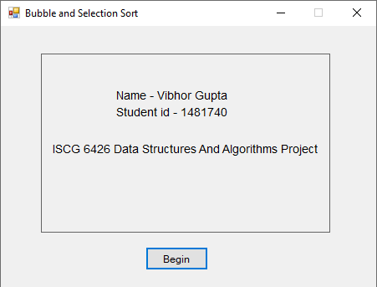
Front Page
This is the front page of the project developed in C# Windows Form Applications.
This page shows the name of the developer, the student ID and the name of the course.

Slide 4
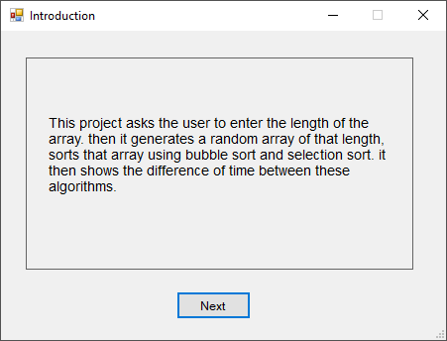
Introduction Page
This is an introduction page of the project.
This page states what the project does.

Slide 5
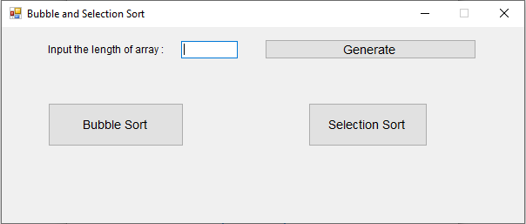
Selection Page
This is the selection page.
This is where the user enters the length of the array to be generated and choose which algorithm to run.
Also, the time taken by the algorithms is shown on this page.

Slide 6
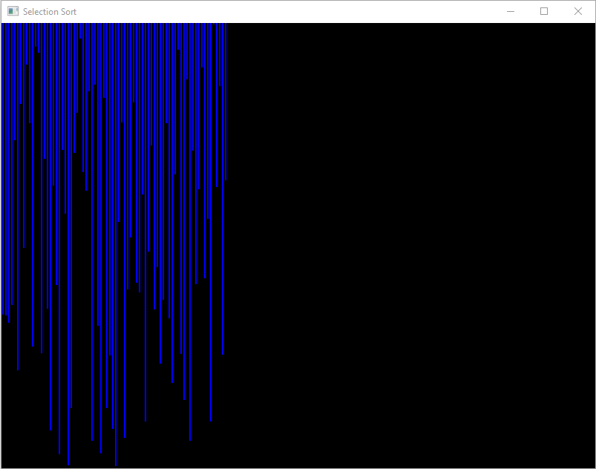
SFML Visualization Page
This is the SFML visualization of the random array being generated.

Slide 7
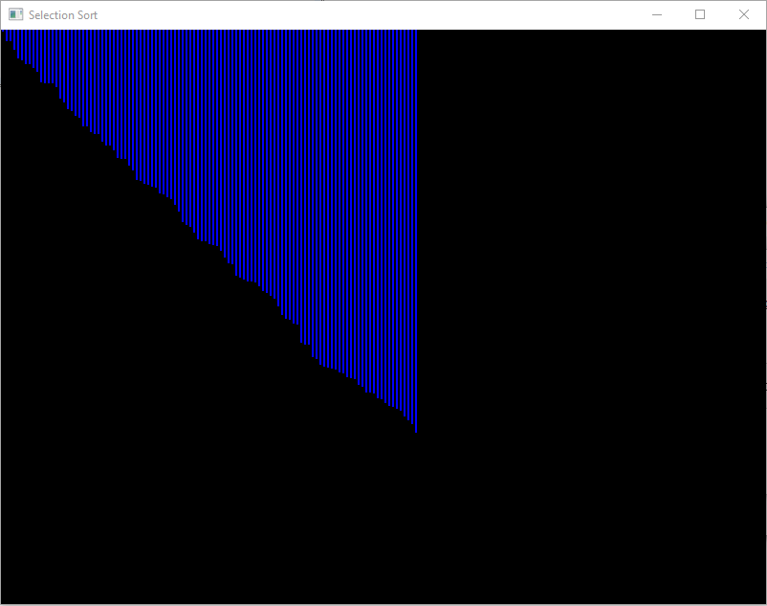
SFML Visualization Page
Once the random array generation has been completed, the project proceeds to sort the array and represent a visualization of the array being sorted.

Slide 8

Generating an array of length 10

Slide 9
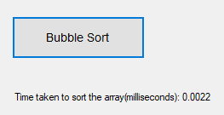
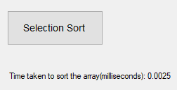
As it can be seen, bubble sort and selection sort took almost the same time to sort the array of length 10, which demonstrates that in small lists bubble sort and selection sort takes the same time to sort the array.

Slide 10
Generating an array of length 150

Slide 11
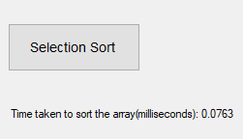
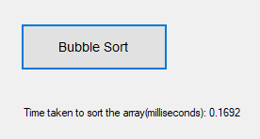
As it can be seen ,bubble sort took more than double the time as selection sort did which shows that bubble sort is less inefficient on long arrays as compared to selection sort.

Slide 12

Questions

